Slide 1


Hospital Availibilty checking System
making easier to find the right hospital

Slide 2
Platform Overview
User-Friendly Interface
Check for availibility of beds and other servivces
Emergency situation handling
Intuitive search and booking process.
Ensuring least time wastage
Doctor appointment

Slide 3

Development Milestones: Phase 1
1
Market Research
Identify target audience and competitor analysis.
2
Platform Design
Create user interface and experience wireframes.
3
MVP Development
Build core features for minimum viable product.

Slide 4

Development Milestones: Phase 2
1
Beta Testing
Launch beta version to local hospitals
2
Feedback Integration
Our representative guide and take feedback
3
Full Launch
A web based platform SAHYOG

Slide 5

Development Milestones: Phase 3
1
Expansion
Add new service categories and features.
2
Mobile Based booking And SOS
Launch dedicated iOS and Android apps.
3
AI Integration
Create SOS alert with Ai to make tthe availibility checking easier

Slide 6
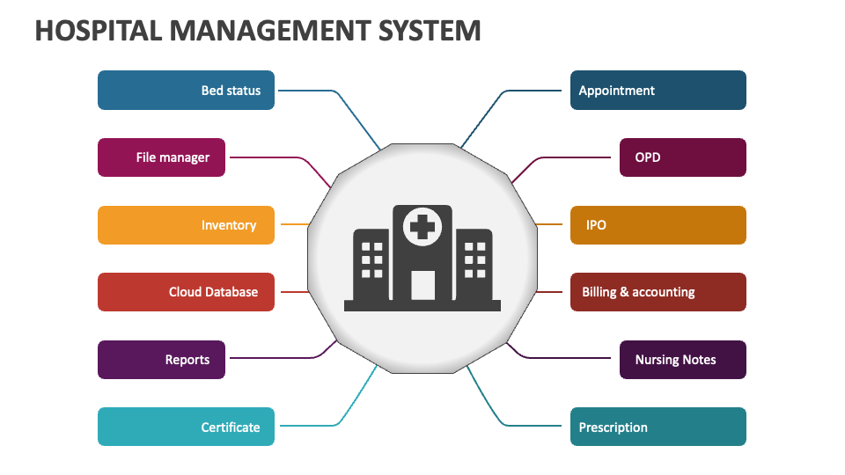




Key Features
Advanced Search
Filter by skills, location, and availability.
Rating System
Transparent feedback for quality assurance.
Scheduling
Integrated calendar for efficient booking.
Identity reviel and data privacy
Protected transactions for both parties.

Slide 7

Market Potential
Local hospitals
D Laboratery
Capitalize on rising freelance workforce trends.
Meet increasing demand for online service platforms.
C NSS workers
G Government health care
Attract diverse range of service providers.
Expand to international markets with localized features.

Slide 8




Investment Opportunity
Seed Funding
Series A
Series B
Initial capital for MVP development.
Scale operations and enhance platform features.
Expand market reach and integrate advanced technologies.

